Slide 1
Finding Programming Errors Earlier by Evaluating Runtime Monitors Ahead-of-Time
McGill University | Eric Bodden
University of Waterloo | Patrick Lam
McGill University | Laurie Hendren

Slide 3
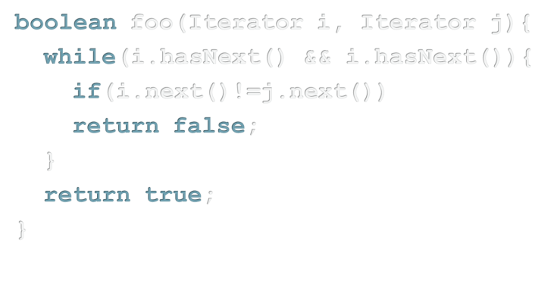
property specification
abc compiler
No missed violations!

Slide 4
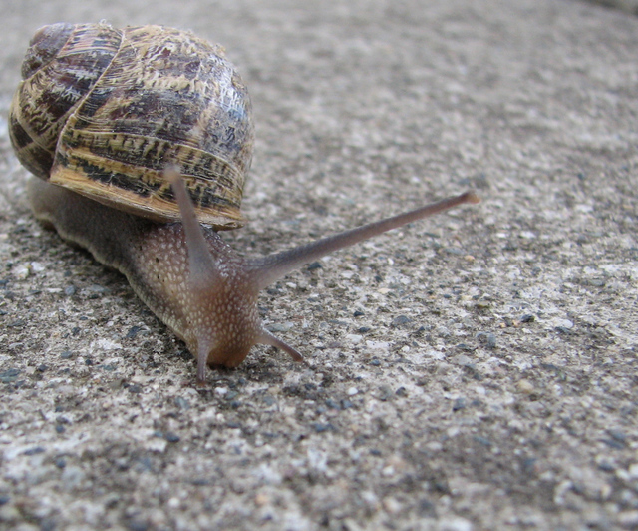
Problem 1:
Potentially large runtime overhead

Slide 5
Problem 2:
Dynamic, with no static guarantees

Slide 6
bug pattern specification
Novel static program analysis
Optimized Runtime
No missed violations!

Slide 7
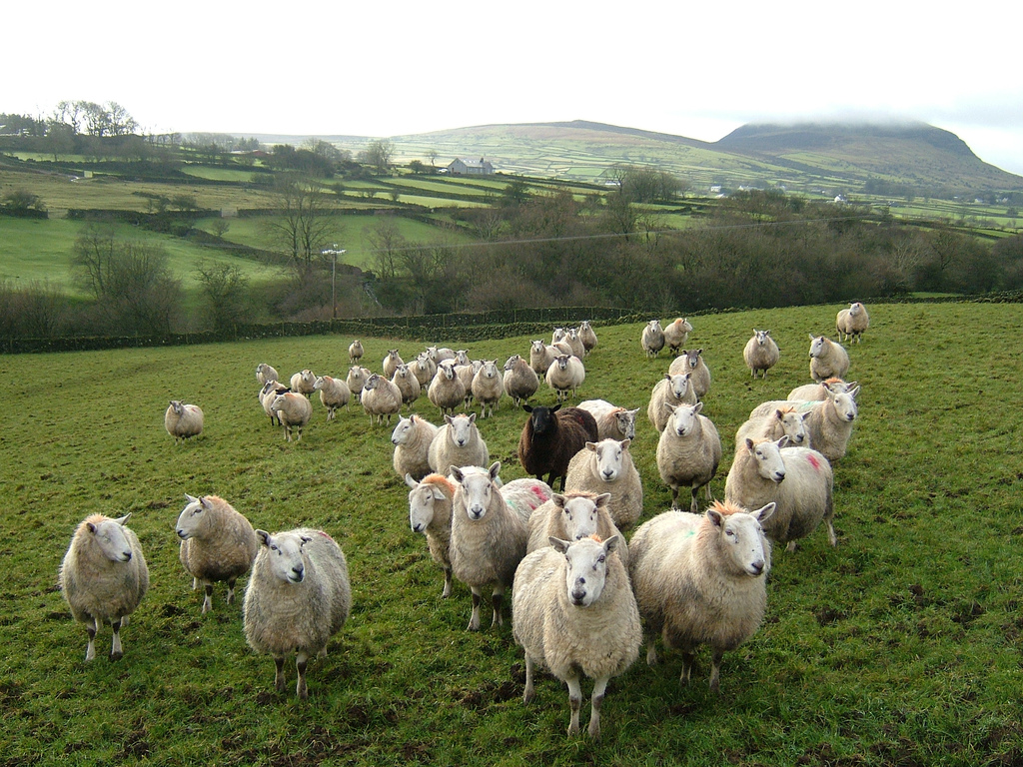
Problem 3:
Existing sound static approaches have many false positives

Slide 8
bug pattern specification
Novel static program analysis
Classification
Likely
Unlikely
foo(..) line 23
bar(..) line 42
bar(..) line 43

Slide 9
Most simple example: HasNext
Don't call next() twice on an Iterator i
without calling hasNext() in between!

Slide 10
Tracematch HasNext
tracematch(Iterator i) {
}
Allan et al., OOPSLA 05

Slide 11
Tracematch HasNext
tracematch(Iterator i) {
sym hasNext after returning:
call(* Iterator.hasNext()) && target(i); sym next after returning:
call(* Iterator.next()) && target(i);
}
Allan et al., OOPSLA 05

Slide 12
Tracematch HasNext
tracematch(Iterator i) {
sym hasNext after returning:
call(* Iterator.hasNext()) && target(i); sym next after returning:
call(* Iterator.next()) && target(i);
next next
}
Allan et al., OOPSLA 05

Slide 13
Tracematch HasNext
tracematch(Iterator i) {
sym hasNext after returning:
call(* Iterator.hasNext()) && target(i); sym next after returning:
call(* Iterator.next()) && target(i);
next next
{
System.out.println( “Called ‘next’ twice on”+i+“!”);
}
}
Allan et al., OOPSLA 05

Slide 14
next, hasNext
next
next
true
i = o(i1)
i = o(i1)
false
i = o(i1)
i = o(i1)
false
i1.next();
i1.hasNext();
i1.next();
i1.next();
{
System.out.println( “Called ‘next’ twice on”+i+“!”);
}

Slide 16
Novel static program analyses

Slide 17
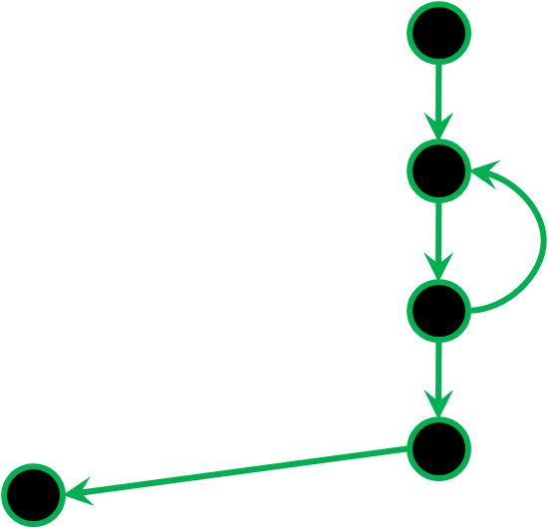
Trade-off: Speed vs. Precision
void foo(Iterator i) {
}

Slide 18
Summary Information
For every program variable i:
What events ever occur on i?
Can program variable j point to the same object as i?
?
“Both hasNext() and next()”
“Only hasNext()”
void foo(Iterator i) {
}

Slide 19
Problem 1: Missing info at method entry
void foo(Iterator i) {
i.next();
}

Slide 20
Key observation!
next, hasNext
next
next
0
1
2
0
0
1
1
2
2
Possible targets of “hasNext”
Possible targets of “next”
→ “hasNext” is a state-determining symbol!

Slide 21
Key observation!
Benchmarks: 68% of symbols are state-determining

Slide 22
Problem 1: Missing info at method entry
void foo(Iterator i) {
if(i.hasNext()) {
i.next();
}
}

Slide 23
Problem 2: Aliasing
void foo(Iterator i) {
if(i.hasNext()) {
Iterator i2=i;
i2.next();
}
}

Slide 24
Object representatives
Whole
program
FI:
Must (Dummy)
Must-not-alias (points-to)
Don’t know
FS:
Must-alias
Must-not-alias
Must
Must-not
Current method
Other method
o1
o3
o2
Precision where we can afford it
Speed where we need it

Slide 25
Problem 3: Outgoing method calls?
void foo(Iterator i) {
if(i.hasNext()) {
bar(i);
i.next();
}
}
bar(i) may only call hasNext() on i!
Summary Information

Slide 26
Problem 4: Continuation of control flow
Can we remove the instrumentation here?
NO!
NO!
void foo(Iterator i) {
if(i.hasNext()) {
i.next();
}
}
No missed violations at runtime!
Rest of program may call next() on i!
void baz(Iterator i) {
foo(i);
i.next();
}
Summary Information

Slide 27
Let the fun begin… binding multiple objects!
For every Collection c and Iterator i:
Don't modify c while i is used on c.

Slide 28
Let the fun begin… binding multiple objects!
void whiz(Collection c1){
Iterator i1 = c1.iterator();
i1.next();
}

Slide 29
Solution: "Uniqueness Check"
Prove that:
i = o(i1) → c = o(c1)
Requires clever combination of pointer analyses (using object representatives).
Summary Information

Slide 30
Benchmarks - Tracematches
ASyncIteration | HasNextElem
FailSafeEnum | LeakingSync
FailSafeIter | Reader
HashMap | Writer
HasNext

Slide 31
Benchmark programs
DaCapo:
antlr | hsqldb
bloat | jython
chart | lucene
eclipse | pmd
fop | xalan
… and SciMark (with 4 extra tracematches)

Slide 32
Results – Elimination of potential failure points
|.........|.........|.........|.........|.........|.........|.........|.........|.........|.........|..
|.........|.........|.........|.........|.........|.........|.........|.........|.........|.........|..
|.........|.........|.........|.........|.........|.........|.........|.........|.........|.........|..
103 program/tracematch combinations
static guarantees in 84 cases
in 14 cases: less than 10 potential failure points

Slide 33
Classification of potential failure points
Likely
Unlikely
foo(..) line 23
bar(…) line 42
bar(…) line 44

Slide 35
Analysis annotates potential failure points
HasNext:
next - <InductionVarAnalyzer.isMu(..)>
@ line 217
next - <InductionVarAnalyzer.isMu(..)>
@ line 218
HasNext:
next - <CodeGenerator.removeEmptyBl(..)>
@ line 587
hasNext - <CodeGenerator.removeEmptyBl(..)>
@ line 586

Slide 36
Analysis annotates potential failure points
HasNext: features []
next - <InductionVarAnalyzer.isMu(..)>
@ line 217
next - <InductionVarAnalyzer.isMu(..)>
@ line 218
HasNext: features [CALL]
next - <CodeGenerator.removeEmptyBl(..)>
@ line 587
hasNext - <CodeGenerator.removeEmptyBl(..)>
@ line 586

Slide 37
Features: Reasons for imprecision
CALL
ABORTED
NO_CONTEXT
DELEGATE
CONTINUATION
DYNAMIC_LOADING
OVERLAPS

Slide 38
Manually annotated actual failure points
HasNext: features [], ACTUAL
next - <InductionVarAnalyzer.isMu(..)>
@ line 217
next - <InductionVarAnalyzer.isMu(..)>
@ line 218
HasNext: features [CALL]
next - <CodeGenerator.removeEmptyBl(..)>
@ line 587
hasNext - <CodeGenerator.removeEmptyBl(..)>
@ line 586

Slide 39
Weka machine learning kit
CALL = 0
| ABORTED = 0
| | DELEGATE = 0
| | | NO_CONTEXT = 0: TRUE_POSITIVE (11.0/1.0)
| | | NO_CONTEXT = 1: FALSE_POSITIVE (4.0/1.0)
| | DELEGATE = 1: FALSE_POSITIVE (10.0)
| ABORTED = 1: FALSE_POSITIVE (30.0)
CALL = 1: FALSE_POSITIVE (406.0/1.0)

Slide 40
Results – Filtering
Found 5 programs with bugs or questionable code.

Slide 42
Related work: Typestate
Static and hybrid verification of typestate props.
Typestate (Strom & Yemini, TSE Vol 12 No. 1, 86)
Fugue for .NET (DeLine & Fähndrich, ECOOP 04)
Typest. & Aliasing (Bierhoff & Aldrich, OOPSLA 07)
Hybrid static/dynamic (Dwyer & Purandare, ASE 07)

Slide 43
Related work: Tracematch-like
Flow-sensitive analysis of Tracematches
Naeem and Lhoták, OOPSLA 08
Other state-based runtime-verification tools for Java
JavaMOP (Chen & Roşu, OOPSLA 08)
PQL (Martin, Livshits & Lam, OOPSLA 05)
PTQL (Goldsmith, O’Callahan & Aiken, OOPSLA 05)

Slide 44
Related work: Static checkers
Static checkers
FindBugs (Hovemeyer & Pugh, OOPSLA 04)
PMD (http://pmd.sf.net/)
Pre and postconditions, invariants
ESC/Java (Flanagan et al., PLDI 02)
Java Modeling Language (JML)
Specialized interprocedural analyses
Jlint (http://artho.com/jlint/)
Comparison: Rutar et al., ISSRE 04

Slide 45
Related work: Invariant mining and checking
Dynamic invariant inference and checking
Daikon (Ernst et al., TSE Vol 27. No 2, 01)
DIDUCE (Hangal & Lam, ICSE 02)
JADET (Wasylkowski et al., FSE 07)
Spec. Mining (Ammons et al., POPL 02)
Static rule mining and checking
PR-Miner (Li & Zhou, FSE 05)
Houdini (Flanagan & Leino, FME 01)

Slide 46
Special thanks to…
Co-workers
Ondřej Lhoták
Nomair Naeem
Maintainers of Tracematch implementation
Pavel Avgustinov
Julian Tibble

Slide 47
www.aspectbench.org
www.bodden.de

Slide 49
Jython / Reader (1/2)
private final void FillBuff() {
...
try {
if ((i = inputStream.read(...)) == -1) {
inputStream.close();
throw new java.io.IOException();
}
else
maxNextCharInd += i;
return;
}
...
}

Slide 50
Jython / Reader (2/2)
static String getLine(BufferedReader reader, int line) {
if (reader == null)
return "";
try {
String text=null;
for(int i=0; i < line; i++) {
text = reader.readLine();
}
return text;
} catch (IOException ioe) {
return null;
}
}

Slide 51
bloat-HasNext
public Block isMu(...) {
...
final Iterator iter = cfg.preds(phi.block()).iterator();
final Block pred1 = (Block) iter.next();
final Block pred2 = (Block) iter.next();

Slide 52
pmd / HasNext (old version)
private List markUsages(IDataFlowNode inode) {
...
for (Iterator k = ((List)entry.getValue())
.iterator();k.hasNext();) {
addAccess(k, inode);
}
...
}
...
private void addAccess(Iterator k, IDataFlowNode inode) {
NameOccurrence occurrence =
(NameOccurrence) k.next();
...
}

Slide 53
pmd / HasNext (fixed version)
private List markUsages(IDataFlowNode inode) {
...
for (NameOccurrence occurrence: entry.getValue()) {
addAccess(occurrence, inode);
}
...
}
...
private void addAccess(NameOccurrence occurrence,
IDataFlowNode inode) {
...
}

Slide 54
Eclipse, false positive
while (c == null && enumMap.hasMoreElements()) {
...
if (!enumC.hasMoreElements())
c = null;
}
// At this point, c == null if there are no more elements,
// and otherwise is the first collection with a free element
// (with enumC set up to return that element).
if (c == null) {
// no more elements, so return null;
return (null);
} else {
Perm answer = (Perm) enumC.nextElement();
...

Slide 55
Jython / hasNext (delegate)
public Iterator iterator() {
return new Iterator() {
Iterator i = list.iterator();
public void remove() {
throw new UnsupportedOperationException();
}
public boolean hasNext() {
return i.hasNext();
}
public Object next() {
return i.next();
}
};
}

Slide 56
Results – Static analysis time
Average total: 6 minutes
Max total: 20 minutes

Slide 57
Delegating calls
public Object next(){
}
DELEGATE
inner.next()
public Object next()

Slide 58
Reasons for imprecision
boolean foo(Iterator i, Iterator j){
}
void bar(..)
bar(i)
CALL

Slide 59
Reasons for imprecision
boolean foz(Set c1, Set c2){
}
i1 = c1.iterator();
public Iterator iterator() {
return new HashIterator();
}
i2 = c2.iterator();
NO_CONTEXT

Slide 60
Reasons for imprecision
3000
1
2
3
4
5
boolean baz(Iterator i, Iterator j){
}
ABORTED

Slide 61
Using alias queries to reduce false-positive rate
Assume we know r1 and r2 must-alias, r1 occurs in some constraint bound to x and we see an event that binds x to r2.
 | x = r1 | x ≠ r1
x = r2 | x = r1 ≡ x = r2 | false
x ≠ r2 | false | x ≠ r1 ≡ x ≠ r2

Slide 62
Using alias queries to reduce false-positive rate
Assume we know r1 and r2 must-not-alias, r1 occurs in some constraint bound to x and we see an event that binds x to r2.
 | x = r1 | x ≠ r1
x = r2 | false | x = r2
x ≠ r2 | x = r1 | x ≠ r1 ^ x ≠ r2

