Slide 1
Dependent Advice A General Approach to Optimizing History-based Aspects
McGill University | Eric Bodden
University of Illinois at Urbana Champaign | Feng Chen
 | Grigore Roşu

Slide 2
AspectJ
as an intermediate language
Various specification languages
LTL spec.
J-LO
JavaMOP
LSC
S2A
History-based
AJ aspect
abc
M2Aspects
tracematches
MSC
MOFScript
relational aspects
Java-STAIRS Aspects

Slide 3
Example concern
Do not write to a disconnected connection.

Slide 4
aspect ConnectionClosed {
Set closed = new WeakIdentityHashSet();
after /∗disconn∗/ (Connection c) returning:
call(∗ Connection.disconnect()) && target(c) {
closed.add(c);
}
after /∗reconn∗/ (Connection c) returning:
call(∗ Connection.reconnect()) && target(c) {
closed.remove(c);
}
before /∗write∗/ (Connection c) :
call(∗ Connection.write (..)) && target(c) {
if (closed.contains(c))
error(c+” is closed !”);
}
}

Slide 5
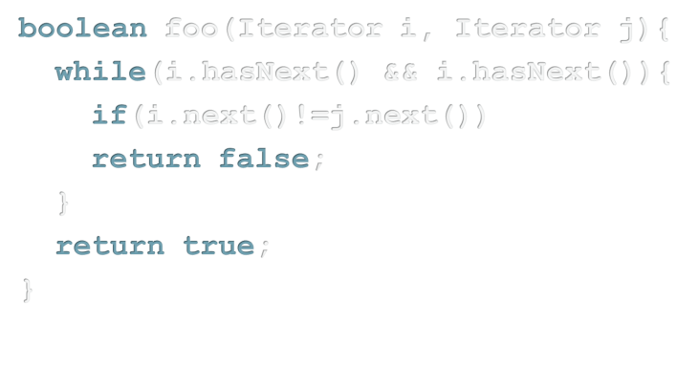
History-based aspect
AspectJ compiler

Slide 6
Problem:
Potentially large runtime overhead

Slide 7
aspect ConnectionClosed {
Set closed = new WeakIdentityHashSet();
after /∗disconn∗/ (Connection c) returning:
call(∗ Connection.disconnect()) && target(c) {
closed.add(c);
}
after /∗reconn∗/ (Connection c) returning:
call(∗ Connection.reconnect()) && target(c) {
closed.remove(c);
}
before /∗write∗/ (Connection c):
call(∗ Connection.write (..)) && target(c) {
if (closed.contains(c))
error(c+” is closed !”);
}
}

Slide 8
Previous work: ECOOP 2007
Now: general case
tracematch
History-based AJ aspects
“disconn write”
Static program analysis
Optimized Runtime

Slide 10
Analyzing history-based aspects?
/* Monitor aspect for HasNext+*/
import java.util.*;
import org.apache.commons.collections.map.*;
class HasNextMonitorPM {
Vector monitorList = new Vector();
synchronized public void hasNext(Iterator i) {
HashSet monitorSet = new HashSet();
Iterator it = monitorList.iterator();
while (it.hasNext()){
HasNextMonitor monitor = (HasNextMonitor)it.next();
monitor.hasNext(i);
if (monitorSet.contains(monitor) || monitor.failed())
it.remove();
else {
monitorSet.add(monitor);
if (monitor.suceeded()){
… about 10 more pages

Slide 11
+ Dependency annotations
History-based AJ aspects
Static program analysis

Slide 12
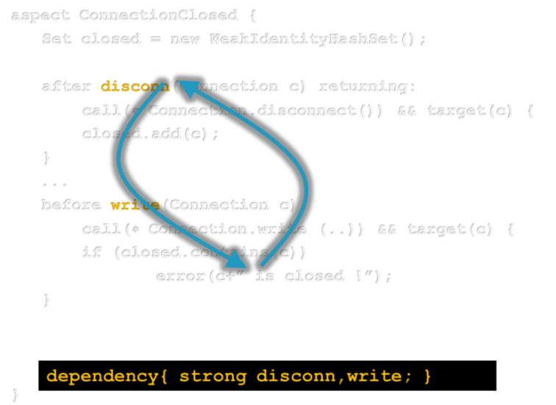
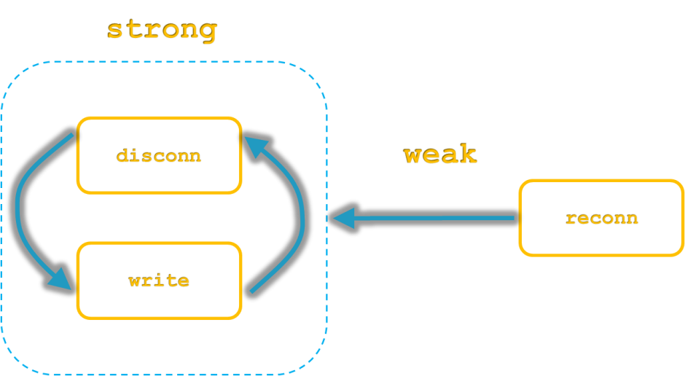
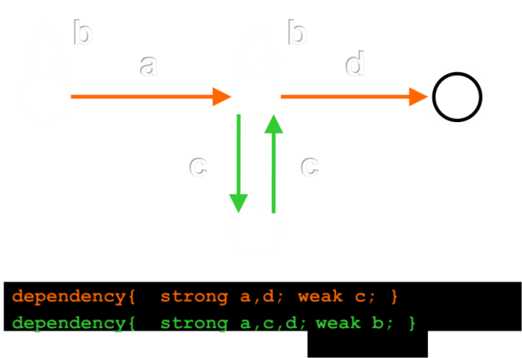
Contributions and Outline
Syntax of dep. advice
Semantics of dep. advice
Generating dep. advice
Experimental results

Slide 13
Dependent advice
aspect ConnectionClosed {
Set closed = new WeakIdentityHashSet();
after disconn(Connection c) returning:
call(∗ Connection.disconnect()) && target(c) {
closed.add(c);
}
...
before write(Connection c):
call(∗ Connection.write (..)) && target(c) {
if (closed.contains(c))
error(c+” is closed !”);
}
}
dependency{ strong disconn,write; }

Slide 14
Dependent advice
aspect ConnectionClosed {
Set closed = new WeakIdentityHashSet();
after disconn(Connection c) returning:
call(∗ Connection.disconnect()) && target(c) {
closed.add(c);
}
after reconn(Connection c) returning:
call(∗ Connection.reconnect()) && target(c) {
closed.remove(c);
}
before write(Connection c):
...
}
dependency{ strong disconn,write; }
dependency{ strong disconn,write; weak reconn; }

Slide 15
“
strong
ly connected”
disconn
“
ly connected”
weak
reconn
write
dependency{ strong disconn,write; weak reconn; }

Slide 16
Verbose syntax
dependency{
strong disconn,write;
weak reconn;
}
after disconn(Connection c)
before write(Connection c)
… is a shorthand for:
after reconn(Connection c)
dependency{
strong disconn(c),write(c);
weak reconn(c);
}

Slide 17
When is a dependency fulfilled?
dependency{
strong disconn(c),write(c);
weak reconn(c);
}
Dependency is fulfilled for Connection c
if both disconn(c) and write(c)
do execute on c at some point in time.

Slide 18
Example
dependency{
strong disconn(c),write(c);
weak reconn(c);
}
Connection c1 = new Connection();
Connection c2 = new Connection();
c1.disconnect();
c2.write(“foo”);
c1.reconnect();
c1.write(“bar”);
→ dependency fulfilled for c1,
but not fulfilled for c2

Slide 19
When does a Dep. Adv. execute?
Dependent advice a must execute at a joinpoint j on objects o if there exists a dependency d that references a and is fulfilled for objects o.

Slide 20
Example
dependency{
strong disconn(c),write(c);
weak reconn(c);
}
Connection c1 = new Connection();
Connection c2 = new Connection();
c1.disconnect();
c2.write(“foo”);
c1.reconnect();
c1.write(“bar”);
?
→ disconn/write/reconn will execute on c1,
do not have to execute (but may) on c2

Slide 21
Optimizing Dependent Advice
Motivated by tracematch-based analysis, Bodden, Hendren & Lhotak (ECOOP 2007)
Two analysis stages:
Quick check
syntactic
Flow-insensitive Orphan-shadows analysis
uses context-sensitive points-to information

Slide 23
Auto-generating dependent advice
Various specification languages
LTL spec.
J-LO
JavaMOP
LSC
S2A
History-based
AJ aspect
abc
M2Aspects
tracematches
MSC
MOFScript
relational aspects
Java-STAIRS Aspects

Slide 24
abc compiler
JavaMOP
tracematch
ERE spec.
FTLTL spec.
PTLTL spec.
Finite-state machine
Finite-state machine
Generic Algorithm
Generic Algorithm
Dependency Declarations

Slide 25
FSM → dependency declarations
b
b
a
d
0
1
3
c,
d
c
c
c
∑
Represents program start
Represents aspect’s visual effect
err
2
Name of dependent advice
a,b,d
dependency{ strong a,d; }
weak c; }
dependency{ strong a,c,d; }
weak b; }

Slide 26
Proven: Algorithm is "stable"
Equivalent automata yield equivalent dependency declarations

Slide 28
Benchmarks - Properties
ASyncIter | FailSafeIterM
ASyncIterM | HasNext
FailSafeEnum | LeakingSync
FailSafeEnumHT | Reader
FailSafeIter | Writer

Slide 29
Benchmarks - Properties
For each of the ten properties:
Hand-coded AspectJ aspect & annotations
Tracematch
Where possible:
JavaMOP specification in ERE
For three specifications also:
JavaMOP specification in FTLTL
JavaMOP specification in PTLTL

Slide 30
Benchmark programs
DaCapo benchmark suite:
antlr | hsqldb
bloat | jython
chart | lucene
eclipse | pmd
fop | xalan

Slide 31
Runtime overhead
380 woven programs

Slide 32
Elimination of all shadows
zero overhead after optimization
72 programs with overhead >10%

Slide 33
Reduction of runtime overhead
average reduction: by 37%
36 programs with overhead >10% and shadows remaining

Slide 34
Limitations
Law-of-Demeter Checker (Lieberherr et al.)
after() returning(Object o):IgnoreTargets() {
ignoredTargets.put(o,o);
}
after(Object thiz,Object targt):
Any.MethodCall(thiz,targt) && !IgnoreCalls() {
if (!ignoredTargets.containsKey(targt) &&
!Pertarget.aspectOf(thiz).contains(targt)){
objectVolations.put(tjSP, tjSP); }
}
¬

Slide 36
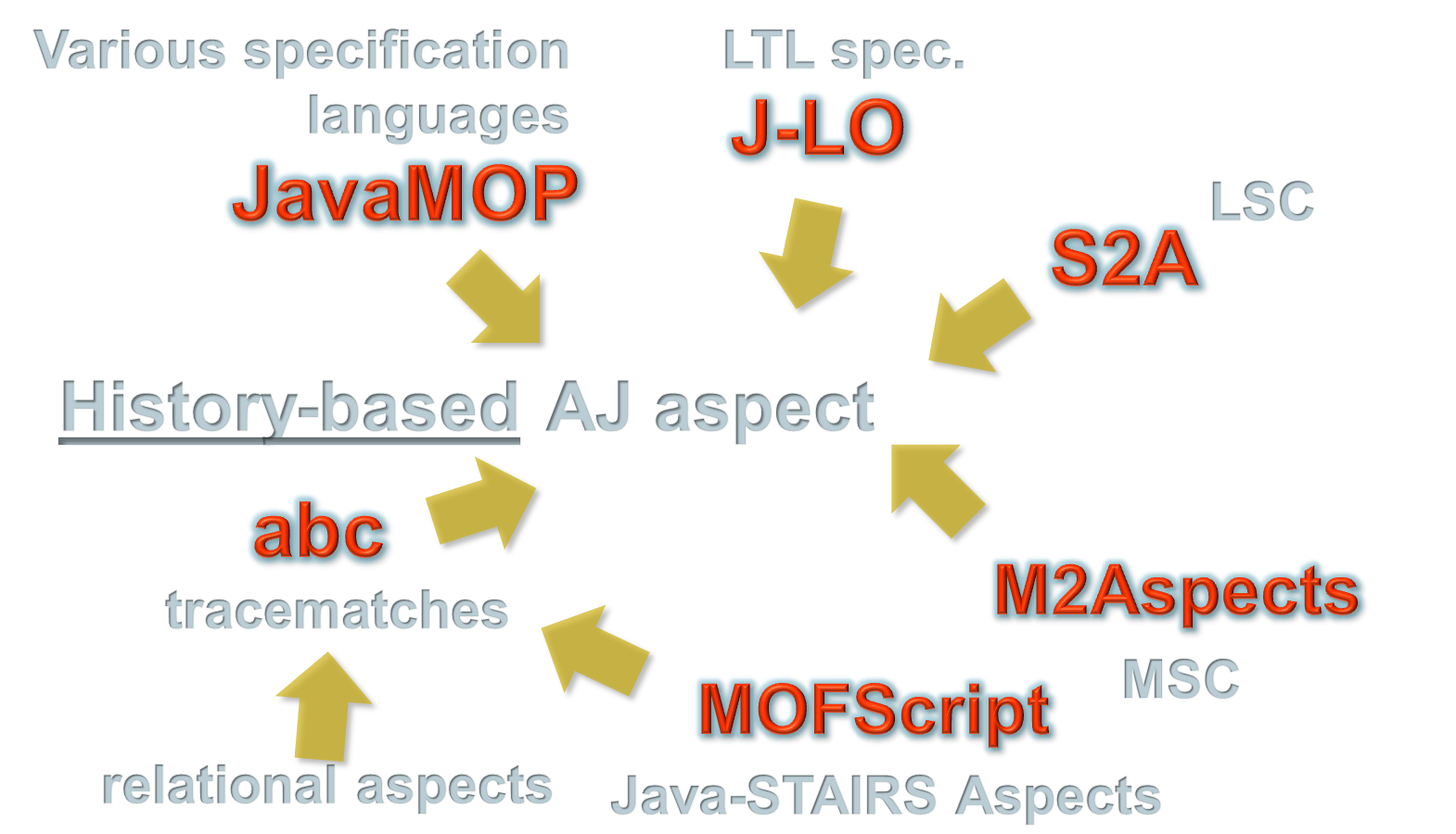
Related work

Slide 37
Related work
Already mentioned:
S2A (Maoz & Harel, FSE 2006)
M2Aspects (Krüger et al., SCESM 2006)
Java-STAIRS Aspects (Oldevik & Haugen, 5pm)
J-LO (Bodden, Diploma Thesis)
Other possible clients of dependent advice:
Association aspects (Sakurai et al., AOSD 2004)
LogicAJ (Kniesel et al., RAM-SE 2004)
Dataflow pointcuts (Masuhara & Kawauchi, APLAS 2003; and tomorrow, 14:30)
Conditional compilation (Adams et al., Friday)

Slide 38
Related work
Optimizations for tracematches:
Bodden, Hendren & Lhotak, ECOOP 2007
Bodden, Lam & Hendren, FSE 2008
Naeem & Lhotak, OOPSLA 2008
Optimizations of the Runtime Monitor:
Avgustinov et al., OOPSLA 2007
Chen & Rosu, TACAS 2009

Slide 39
Important conclusion
Approach hard to formalize without AOP
History-based aspect modularizes instrumentation
Hence can use modular dependency annotation

Slide 40
Acknowledgements
co-workers:
Laurie Hendren
Patrick Lam
developer of S2A:
Shahar Maoz
abc/tracematch maintainers:
Pavel Avgustinov
Julian Tibble

Slide 42
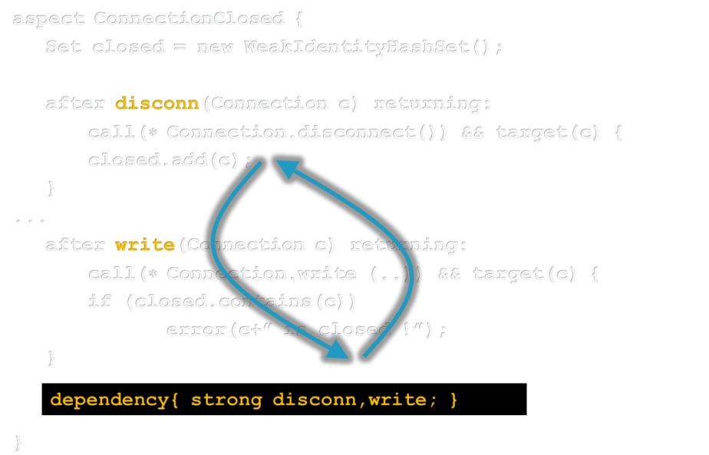
www.aspectbench.org
www.bodden.de

Slide 45
Static analysis
dependency{
strong disconn(c),write(c);
weak reconn(c);
}
Connection c1 = new Connection(); //(1)
Connection c2 = new Connection(), c3; //(2)
c1.disconnect();
c2.write(“foo”);
c1.reconnect();
c3 = c1;
c3.write(“bar”);

Slide 46
Results – Static-analysis time
Average total: 12 minutes
Max total: 58 minutes

